Slide 1
Track Prediction of Tropical Cyclone via Bayesian Model Averaging
Ching-Chi Yang

Slide 2
Outline
Background
Problem formulation
Bayesian Model Averaging
Results

Slide 3
Tropical Cyclone Tracks
For example, where will the center of hurricane move to after 48 hrs.?

Slide 4
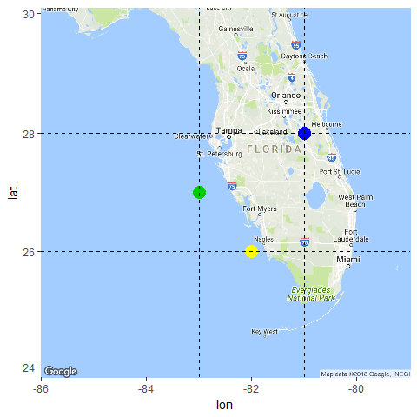
Tropical cyclone’s track prediction
M1
M2
M3

Slide 5
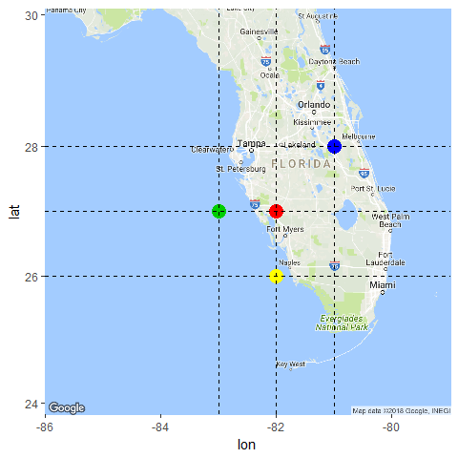
Average: equal weights (Dong and Zhang 2016)
M1
M2
New
M3
Notes:
Lin Dong and Fuqing Zhang

Slide 6
Problem formulation
Given performance of the past forecasting, could we provide a more accurate prediction?
Track error: the distance from
the predicted location to
the actual location
Evaluate track errors over a year:
annual mean absolute errors (MAE)
annual root-mean-square errors (RMSE)

Slide 7
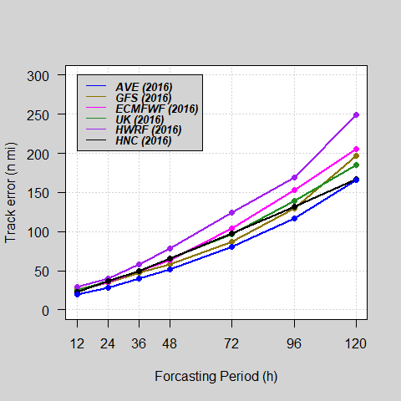
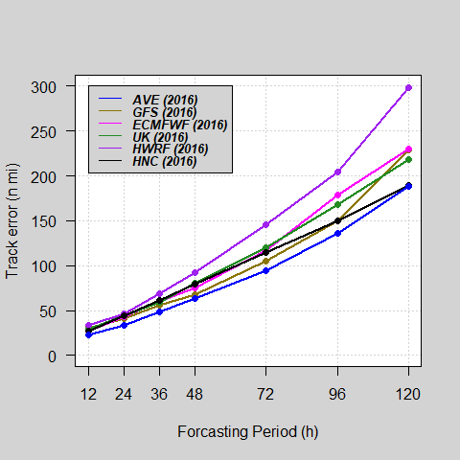
Example: Average (2016)
MAE | RMSE

Slide 8
Bayesian Model Averaging
A distribution which combines the opinions of models.
A weighted averaged of posterior distributions of models.
Model selection.

Slide 9
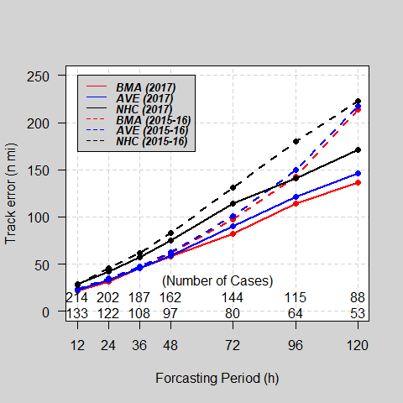
BMA, Ave, and NHC
MAE

Slide 10
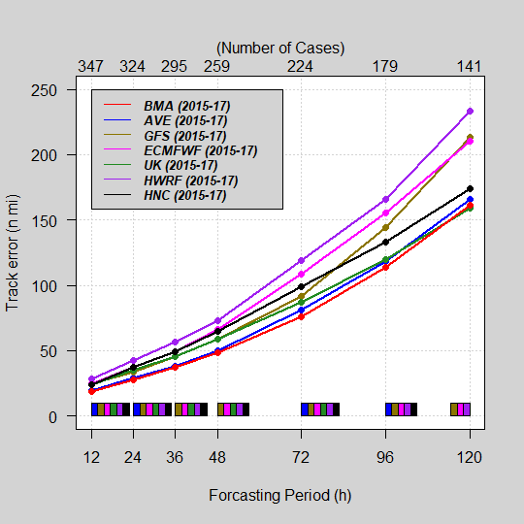
Result from 15 to 17
MAE

Slide 11
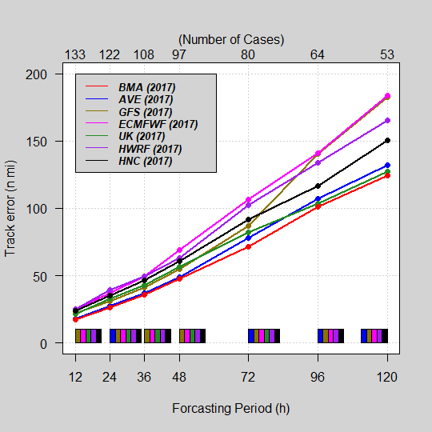
Result in 2017
MAE

Slide 12
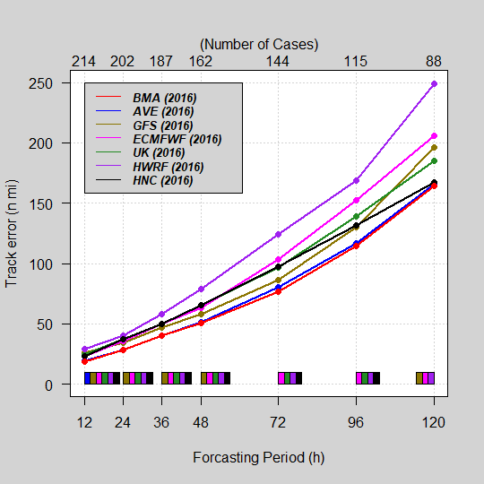
Result in 2016
MAE

Slide 13
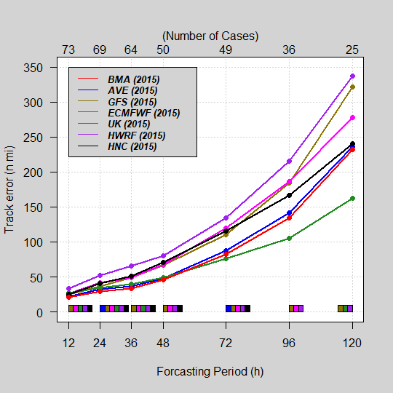
Result in 2015
MAE

Slide 14
Conclusion
72-hr predictions: BMA is highly recommended cross all models.
BMA outperforms NHC.
BMA performs better than Average.
UK Met Office are better for 120-hr predictions in 2015.

Slide 15
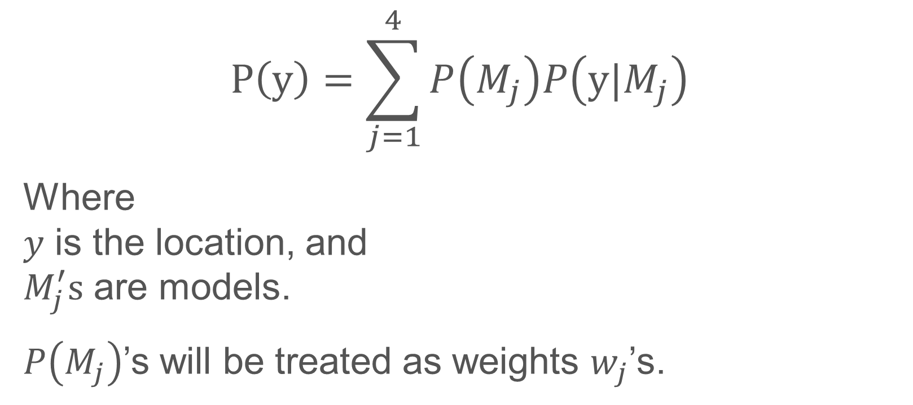
Bayesian Model Averaging
$$P\left(y\right)=\sum_{j=1}^{4}{P\left(M_{j}\right)P\left(y|M_{j}\right)}$$
Where $y$ is the location, and $M_{j}^{′}s$ are models.
$P\left(M_{j}\right)$’s will be treated as weights $w_{j}$’s.

Slide 16
Thank you

Slide 17
Example for working trough BMA
Let’s focus on the 48-hr prediction first.
The entire history up to the current stage, say, 2015/05/08 12:00 (total 42 cases)
Model | YYMMDDHH | Ptime | PLat | PLon | VLat | VLon
UK | 14070200 | 14070400 | -77.2 | 33.4 | -77.3 | 34.0
GFS | 14070200 | 14070400 | -77.3 | 33.5 | -77.3 | 34.0
ECMWF | 14070200 | 14070400 | -77.8 | 32.6 | -77.3 | 34.0
HWRF | 14070200 | 14070400 | -78.1 | 33.5 | -77.3 | 34.0
... | ... | ... | ... | ... | ... | …

Slide 18
Conditional probability
$$P\left(y|M_{j}\right)$$
Where $y$ is the predicted location, $(Lon, Lat)$, and $M_{j}^{′}s$ are models.
The mode of the distribution is provided by model $j$.
The spread/distribution is unknown.

Slide 19
Bayesian Model Averaging
$$P\left(y\right)=\sum_{j=1}^{4}{P\left(M_{j}\right)P\left(y|M_{j}\right)}$$
Where $y$ is the location, and $M_{j}^{′}s$ are models.
$P\left(M_{j}\right)$’s will be treated as weights $w_{j}$’s.

Slide 20
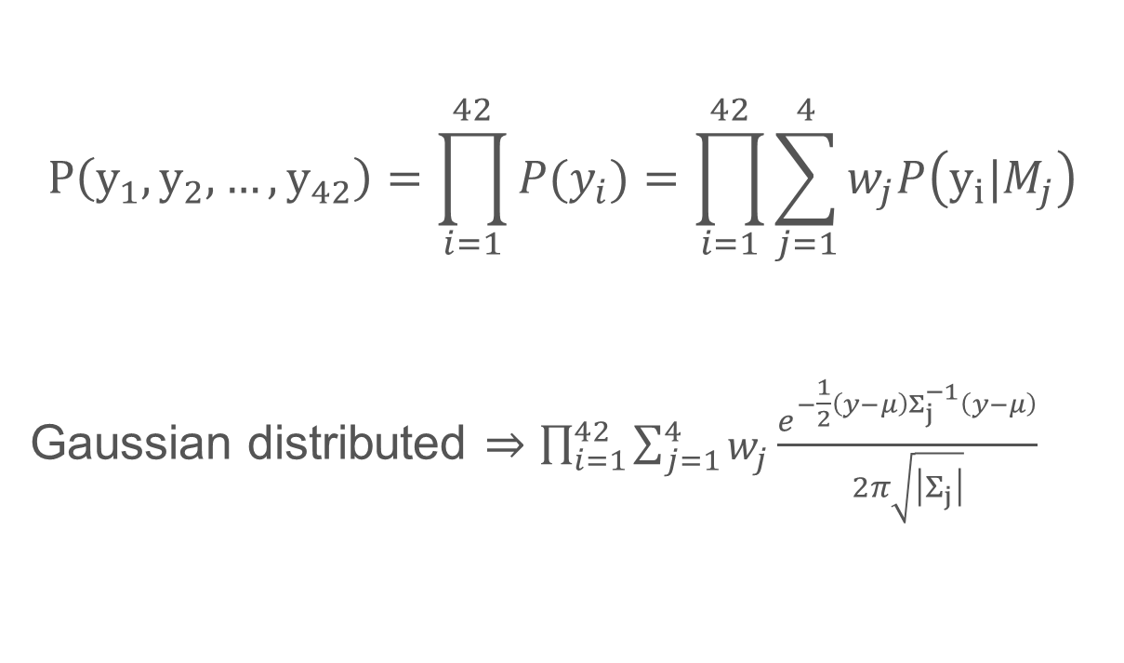
Joint probability
$$P\left(y_{1},y_{2},…,y_{42}\right)=\prod_{i=1}^{42}{P(y_{i})}=\prod_{i=1}^{42}{\sum_{j=1}^{4}{w_{j}P\left(y_{i}|M_{j}\right)}}$$ Gaussian distributed $⇒\prod_{i=1}^{42}{\sum_{j=1}^{4}{w_{j}\frac{e^{−\frac{1}{2}\left(y−μ\right)Σ_{j}^{−1}\left(y−μ\right)}}{2π\sqrt{\left|Σ_{j}\right|}}}}$

Slide 21
Technical details
The collected locations are treated as realizations from the normal distribution.
The dispersion can be depended on model, e.g., $Δ_{t}|M_{j} \sim N\left(μ_{j,t},Σ_{j}\right)$.
After our investigation, $Σ_{j}$’s do not differ significantly; assume $Σ=Σ_{1}=Σ_{2}$ $=Σ_{3}$ $=Σ_{4}$.

